Slide 1
Introduction to Vectors

Slide 2
A vector is a quantity that requires both a magnitude and a direction for a complete description. Examples of vectors are weight, velocity and friction. On the other hand, a scalar is a magnitude that can be completely specified by just one number. Examples of scalars include age, volume, area, speed, mass and temperature.
A vector can be represented by a directed line segment. The magnitude of the vector is indicated by the length of the line segment, and the direction of the vector is indicated by an arrowhead on the end of the segment.

Slide 3

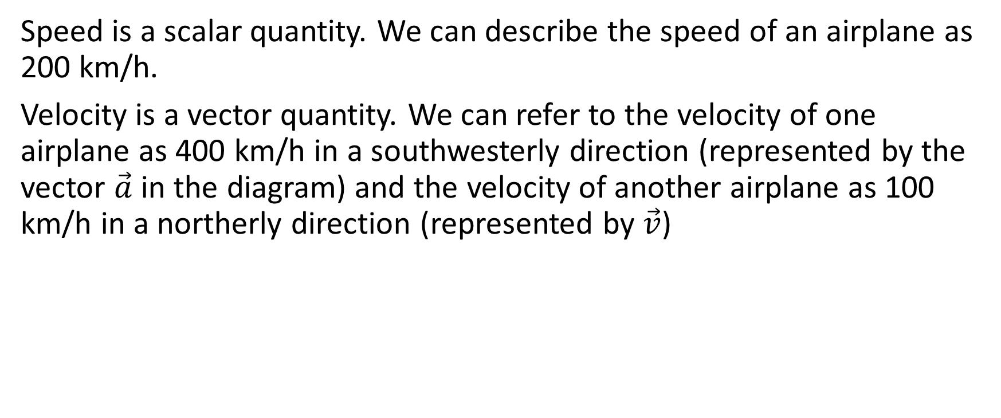

Speed is a scalar quantity. We can describe the speed of an airplane as 200 km/h.
Velocity is a vector quantity. We can refer to the velocity of one airplane as 400 km/h in a southwesterly direction (represented by the vector $\vec{a}$ in the diagram) and the velocity of another airplane as 100 km/h in a northerly direction (represented by $\vec{v}$)
$$\vec{a}$$
$$\vec{v}$$

Slide 4
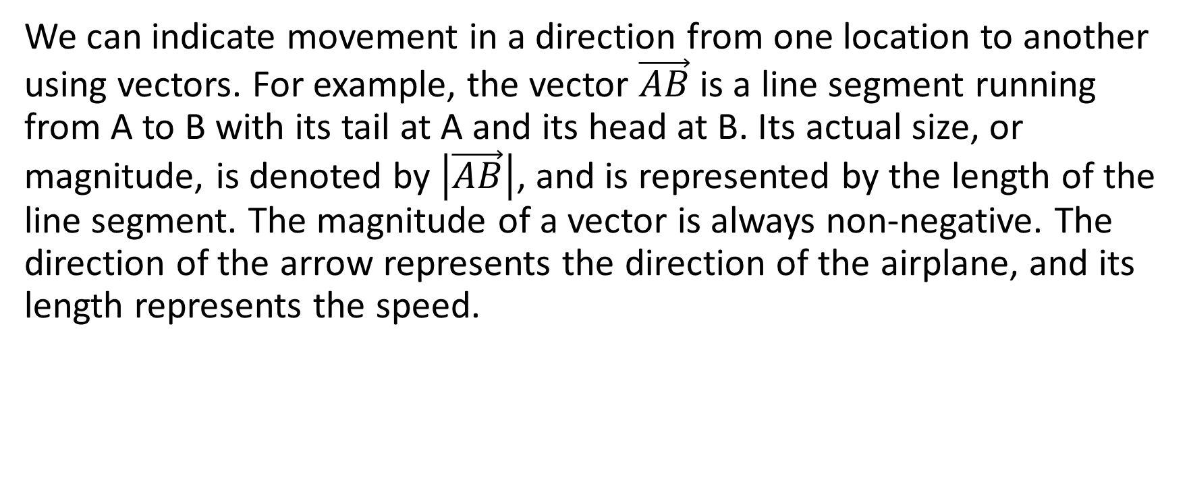
We can indicate movement in a direction from one location to another using vectors. For example, the vector $\vec{AB}$ is a line segment running from A to B with its tail at A and its head at B. Its actual size, or magnitude, is denoted by $\left|\vec{AB}\right|$, and is represented by the length of the line segment. The magnitude of a vector is always non-negative. The direction of the arrow represents the direction of the airplane, and its length represents the speed.

Slide 5
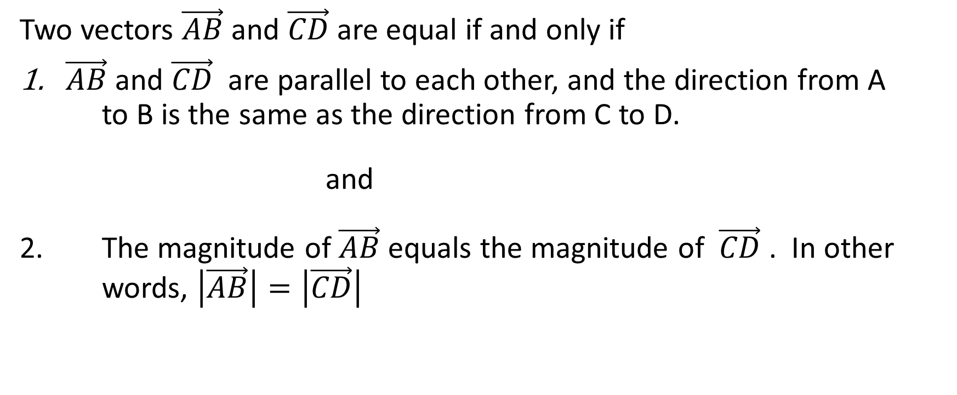
Equal vectors
Two vectors $\vec{AB}$ and $\vec{CD}$ are equal if and only if
$\vec{AB}$ and $\vec{CD}$ are parallel to each other, and the direction from A to B is the same as the direction from C to D.
and
2. The magnitude of $\vec{AB}$ equals the magnitude of $\vec{CD}$ . In other words, $\left|\vec{AB}\right|=\left|\vec{CD}\right|$

Slide 6
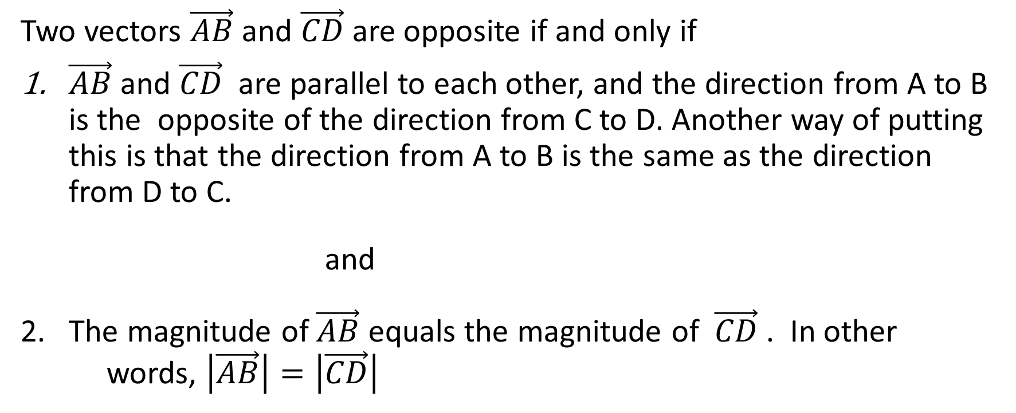
Opposite vectors
Two vectors $\vec{AB}$ and $\vec{CD}$ are opposite if and only if
$\vec{AB}$ and $\vec{CD}$ are parallel to each other, and the direction from A to B is the opposite of the direction from C to D. Another way of putting this is that the direction from A to B is the same as the direction from D to C.
and
2. The magnitude of $\vec{AB}$ equals the magnitude of $\vec{CD}$ . In other words, $\left|\vec{AB}\right|=\left|\vec{CD}\right|$

Slide 7
Vector Addition

Slide 8
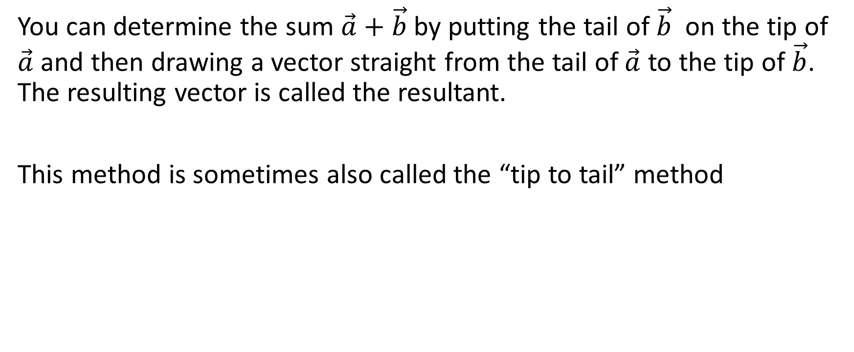
Triangle Law of Addition of Vectors
You can determine the sum $\vec{a}+\vec{b}$ by putting the tail of $\vec{b}$ on the tip of $\vec{a}$ and then drawing a vector straight from the tail of $\vec{a}$ to the tip of $\vec{b}$. The resulting vector is called the resultant.
This method is sometimes also called the “tip to tail” method

Slide 9



.
$$\vec{b}$$
$$\vec{a}$$
$$\vec{a}+\vec{b}$$

Slide 10
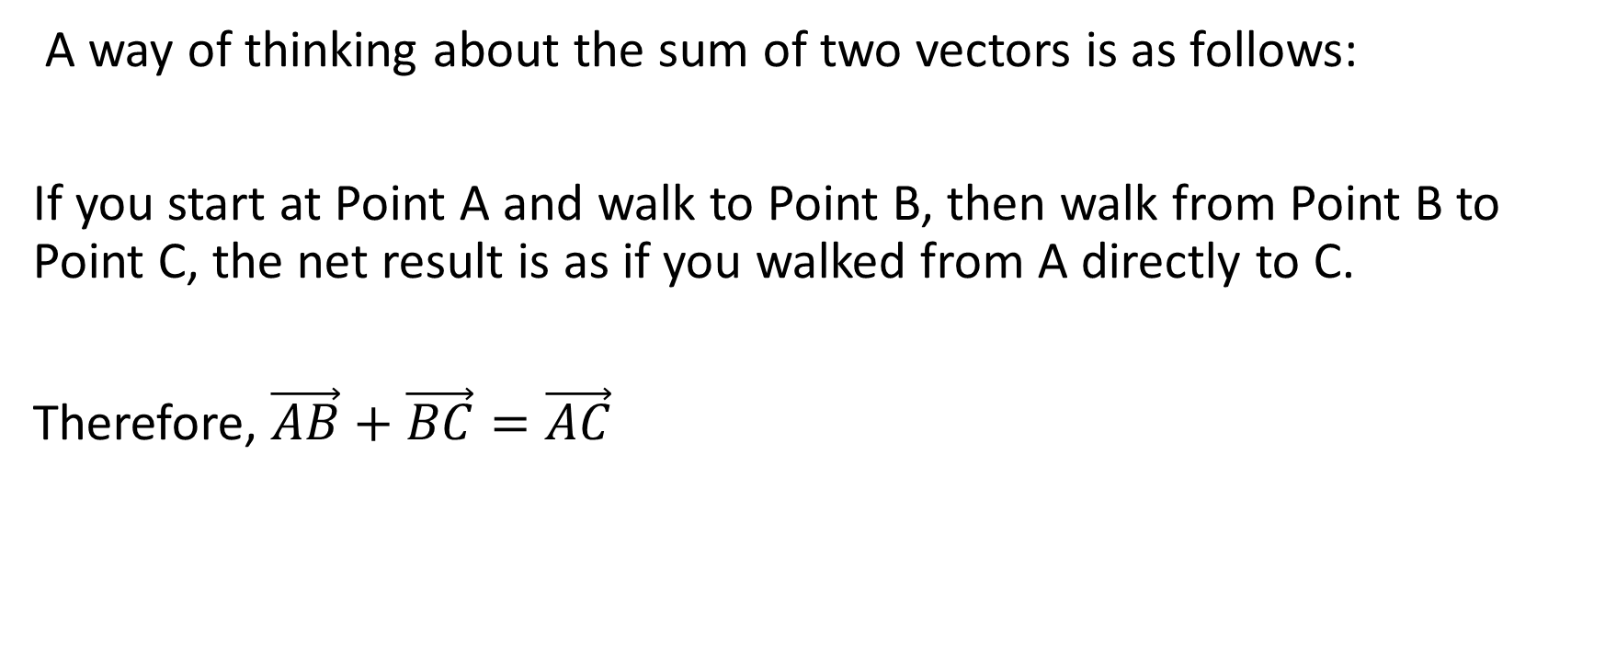
A way of thinking about the sum of two vectors is as follows:
If you start at Point A and walk to Point B, then walk from Point B to Point C, the net result is as if you walked from A directly to C.
Therefore, $\vec{AB}+\vec{BC}=\vec{AC}$

Slide 11
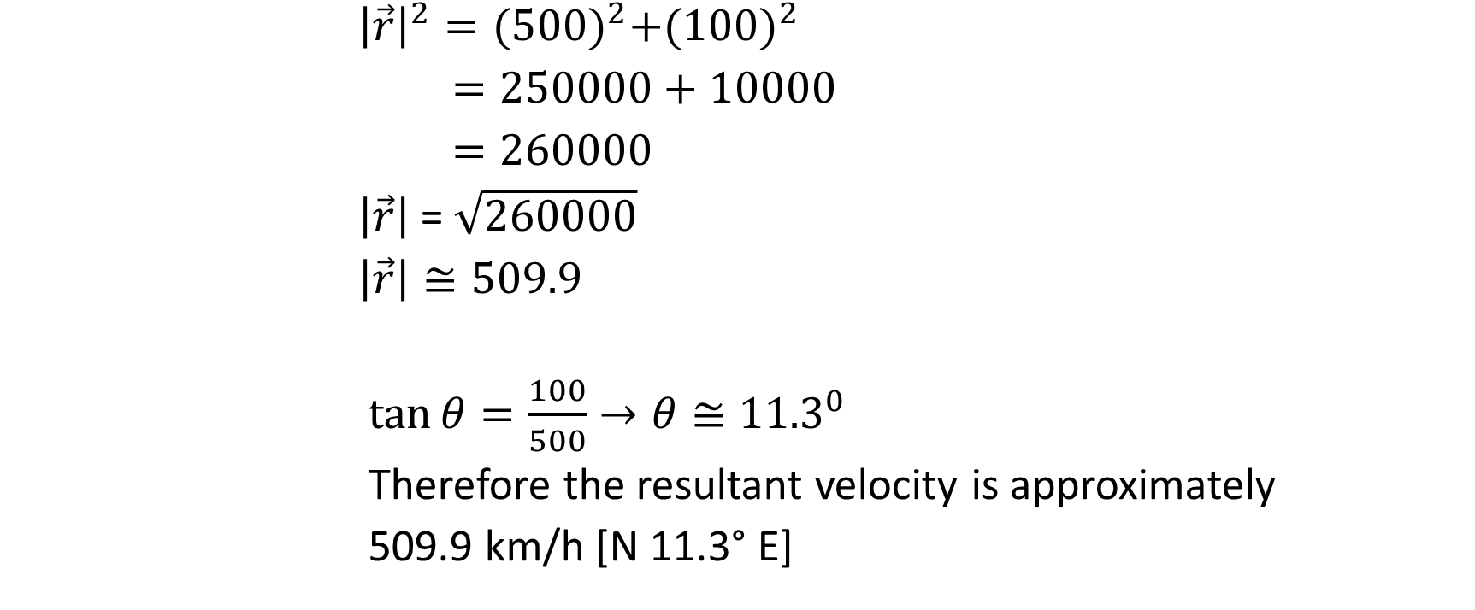

Suppose that an airplane is traveling with a component velocity of 500 km/h N when it encounters a wind blowing with a velocity of 100 km/h E. What is the resultant velocity?
${\left|\vec{r}\right|}^{2}={(500)}^{2}+{(100)}^{2}$
$=250000+10000$
$=260000$
$\left|\vec{r}\right|$ = $\sqrt{260000}$
$\left|\vec{r}\right|≅509.9$
$\tan{θ}=\frac{100}{500}→θ≅{11.3}^{0}$
Therefore the resultant velocity is approximately
509.9 km/h [N 11.3° E]

Slide 12
Angle Between Two Vectors
When you are told the angle between two vectors, it is always the angle between those vectors if they are drawn tail to tail.
Note, however, that often when we add two vectors, the angle that we use for our sin law or cos law calculations will not be that same value.

Slide 13
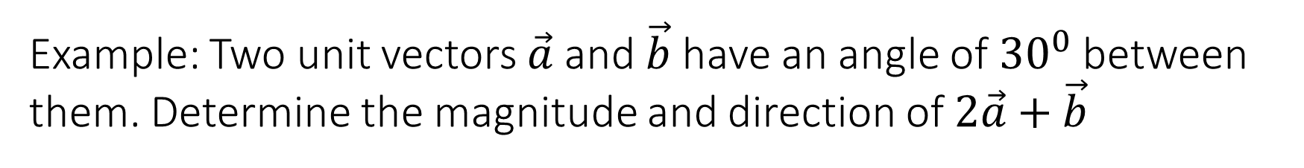

Example: Two unit vectors $\vec{a}$ and $\vec{b}$ have an angle of ${30}^{0}$ between them. Determine the magnitude and direction of $2\vec{a}+\vec{b}$
A unit vector is a vector with a magnitude of 1.

Slide 14
Example: Two unit vectors $\vec{a}$ and $\vec{b}$ have an angle of ${30}^{0}$ between them. Determine the magnitude and direction of $2\vec{a}+\vec{b}$
A unit vector is a vector with a magnitude of 1.
Now, consider what the above vectors would look like tip to tail

Slide 15
Example: Two unit vectors $\vec{a}$ and $\vec{b}$ have an angle of ${30}^{0}$ between them. Determine the magnitude and direction of $2\vec{a}+\vec{b}$
A unit vector is a vector with a magnitude of 1.
Now, consider what the above vectors would look like tip to tail

Slide 16

Example: Two unit vectors $\vec{a}$ and $\vec{b}$ have an angle of ${30}^{0}$ between them. Determine the magnitude and direction of $2\vec{a}+\vec{b}$
A unit vector is a vector with a magnitude of 1.
Now, consider what the above vectors would look like tip to tail

Slide 17
Example: Two unit vectors $\vec{a}$ and $\vec{b}$ have an angle of ${30}^{0}$ between them. Determine the magnitude and direction of $2\vec{a}+\vec{b}$
A unit vector is a vector with a magnitude of 1.
There is a C-pattern with horizontal lines.

Slide 18
Example: Two unit vectors $\vec{a}$ and $\vec{b}$ have an angle of ${30}^{0}$ between them. Determine the magnitude and direction of $2\vec{a}+\vec{b}$
A unit vector is a vector with a magnitude of 1.
There is a C-pattern with horizontal lines. Therefore,
α + 30° = 180°
α = 150°

Slide 19

Example: Two unit vectors $\vec{a}$ and $\vec{b}$ have an angle of ${30}^{0}$ between them. Determine the magnitude and direction of $2\vec{a}+\vec{b}$
A unit vector is a vector with a magnitude of 1.

Slide 20



Example: Two unit vectors $\vec{a}$ and $\vec{b}$ have an angle of ${30}^{0}$ between them. Determine the magnitude and direction of $2\vec{a}+\vec{b}$
A unit vector is a vector with a magnitude of 1.
The vector $2\vec{a}$ has a magnitude of 2, and the vector $\vec{b}$ has a magnitude of 1. We can draw them tip to tail as follows

Slide 21
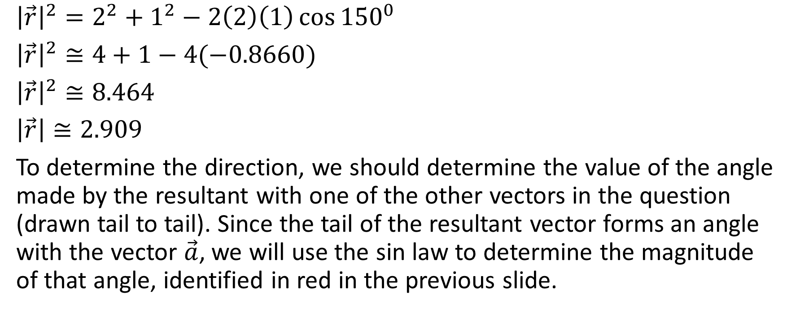
${\left|\vec{r}\right|}^{2}=2^{2}+1^{2}−2\left(2\right)\left(1\right)\cos{{150}^{0}}$
${\left|\vec{r}\right|}^{2}≅4+1−4(−0.8660)$
${\left|\vec{r}\right|}^{2}≅8.464$
$\left|\vec{r}\right|≅2.909$
To determine the direction, we should determine the value of the angle made by the resultant with one of the other vectors in the question (drawn tail to tail). Since the tail of the resultant vector forms an angle with the vector $\vec{a}$, we will use the sin law to determine the magnitude of that angle, identified in red in the previous slide.

Slide 22
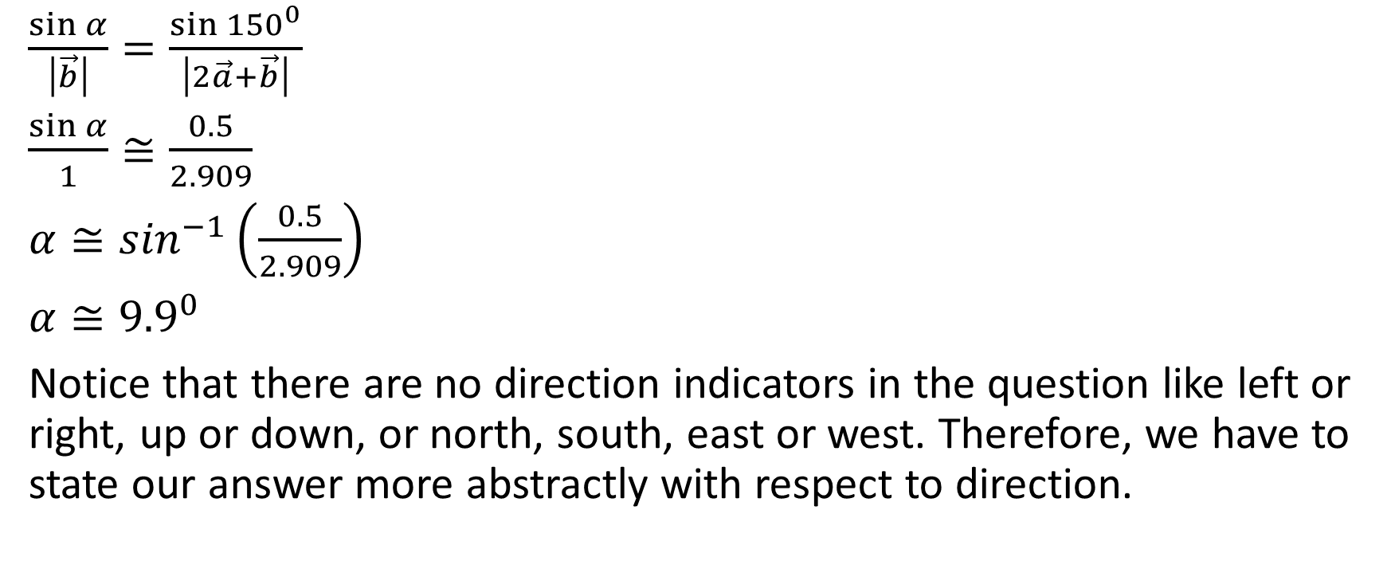
$\frac{\sin{α}}{\left|\vec{b}\right|}=\frac{\sin{{150}^{0}}}{\left|2\vec{a}+\vec{b}\right|}$
$\frac{\sin{α}}{1}≅\frac{0.5}{2.909}$
$α≅\sin^{−1}\left(\frac{0.5}{2.909}\right)$
$α≅{9.9}^{0}$
Notice that there are no direction indicators in the question like left or right, up or down, or north, south, east or west. Therefore, we have to state our answer more abstractly with respect to direction.

Slide 23



The resultant vector was rotated approximately ${9.9}^{0}$ from the vector $2\vec{a}$ clockwise towards the vector $\vec{b}$. However, the vector $2\vec{a}$ is not given in the question, so we will refer to the vector $\vec{a}$, not $2\vec{a}$, in our answer.

Slide 24
Also, we can’t refer to counterclockwise, because that came from the way we drew the initial diagram. So, to be as general as possible using only information given in the question, we write the answer as follows:

Slide 25

The resultant vector has a magnitude of approximately 2.909, in a direction of approximately ${9.9}^{0}$rotated from $\vec{a}$ towards $\vec{b}$

Slide 26


Example:
Suppose that $\left|\vec{u}\right|=4$ and $\left|\vec{v}\right|=5$ and the angle between $\vec{u}$ and $\vec{v}$ is 120°. Determine $\vec{u}+\vec{v}$.
Solution:

Slide 27
Suppose that $\left|\vec{u}\right|=4$ and $\left|\vec{v}\right|=5$ and the angle between $\vec{u}$ and $\vec{v}$ is 120°. Determine $\vec{u}+\vec{v}$.
Solution:

Slide 28

Suppose that $\left|\vec{u}\right|=4$ and $\left|\vec{v}\right|=5$ and the angle between $\vec{u}$ and $\vec{v}$ is 120°. Determine $\vec{u}+\vec{v}$.
Solution:

Slide 29






Suppose that $\left|\vec{u}\right|=4$ and $\left|\vec{v}\right|=5$ and the angle between $\vec{u}$ and $\vec{v}$ is 120°. Determine $\vec{u}+\vec{v}$.
Solution:

Slide 30
Suppose that $\left|\vec{u}\right|=4$ and $\left|\vec{v}\right|=5$ and the angle between $\vec{u}$ and $\vec{v}$ is 120°. Determine $\vec{u}+\vec{v}$.
Solution:

Slide 31




Suppose that $\left|\vec{u}\right|=4$ and $\left|\vec{v}\right|=5$ and the angle between $\vec{u}$ and $\vec{v}$ is 120°. Determine $\vec{u}+\vec{v}$.
Solution:

Slide 32




Suppose that $\left|\vec{u}\right|=4$ and $\left|\vec{v}\right|=5$ and the angle between $\vec{u}$ and $\vec{v}$ is 120°. Determine $\vec{u}+\vec{v}$.
Solution:

Slide 33







Suppose that $\left|\vec{u}\right|=4$ and $\left|\vec{v}\right|=5$ and the angle between $\vec{u}$ and $\vec{v}$ is 120°. Determine $\vec{u}+\vec{v}$.
Solution:

Slide 34



Suppose that $\left|\vec{u}\right|=4$ and $\left|\vec{v}\right|=5$ and the angle between $\vec{u}$ and $\vec{v}$ is 120°. Determine $\vec{u}+\vec{v}$.
Solution:

Slide 35








Suppose that $\left|\vec{u}\right|=4$ and $\left|\vec{v}\right|=5$ and the angle between $\vec{u}$ and $\vec{v}$ is 120°. Determine $\vec{u}+\vec{v}$.
Solution:

Slide 36
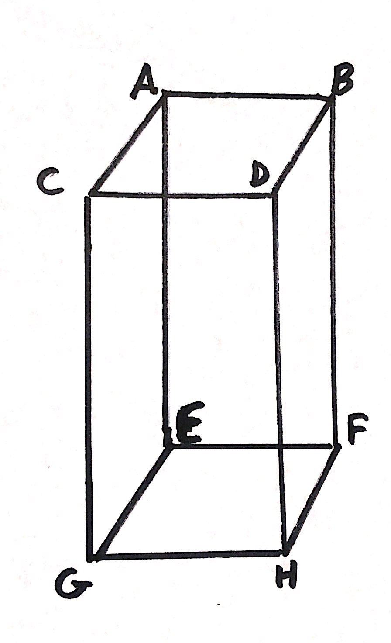
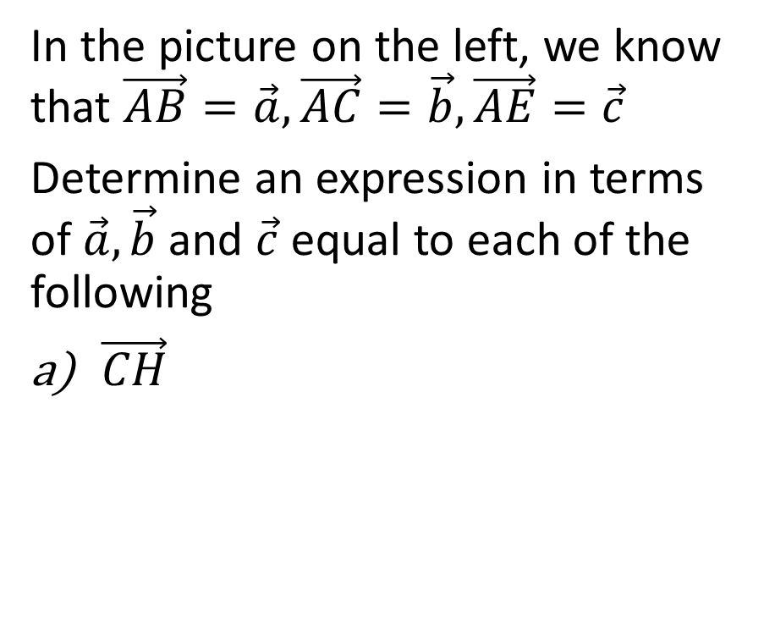
Example
In the picture on the left, we know that $\vec{AB}=\vec{a},\vec{AC}=\vec{b},\vec{AE}=\vec{c}$
Determine an expression in terms of $\vec{a}, \vec{b}$ and $\vec{c}$ equal to each of the following
$\vec{CH}$

Slide 37
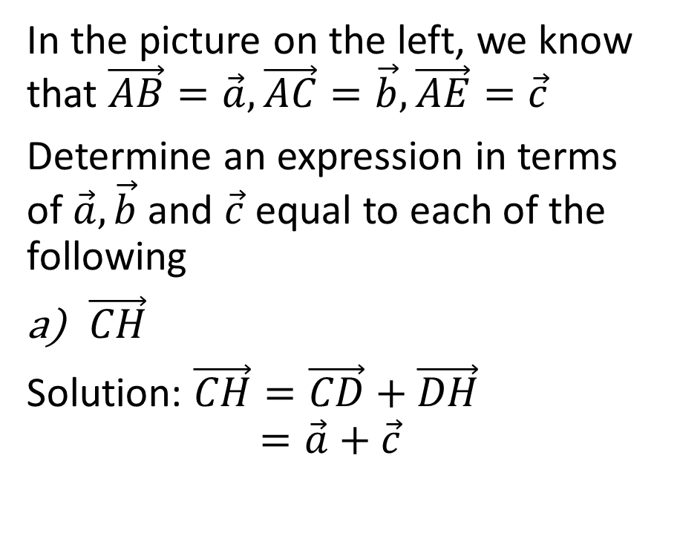
Example
In the picture on the left, we know that $\vec{AB}=\vec{a},\vec{AC}=\vec{b},\vec{AE}=\vec{c}$
Determine an expression in terms of $\vec{a}, \vec{b}$ and $\vec{c}$ equal to each of the following
$\vec{CH}$
Solution: $\vec{CH}=\vec{CD}+\vec{DH}$
$$=\vec{a}+\vec{c}$$

Slide 38
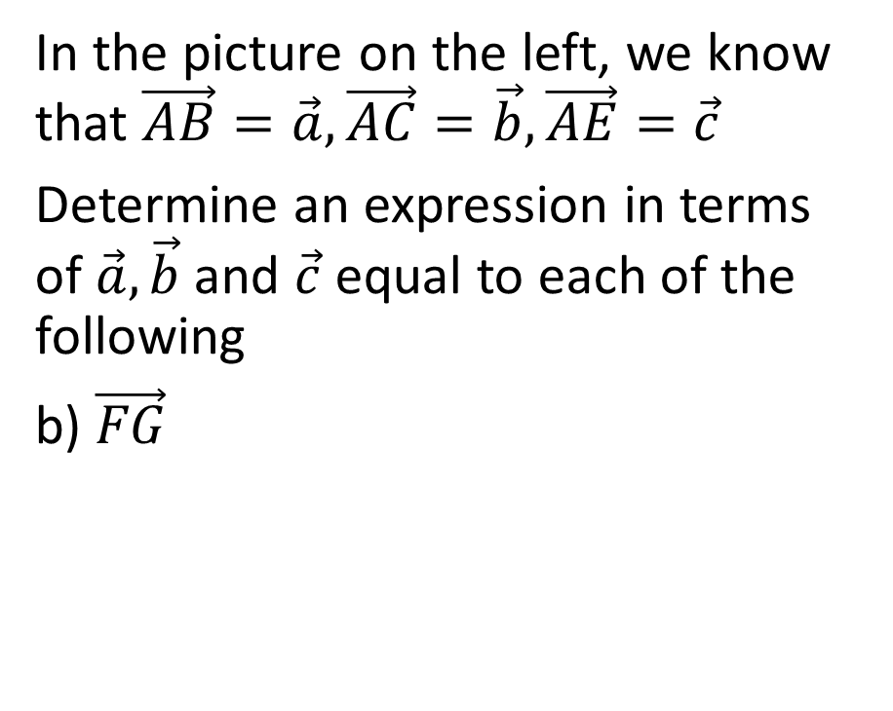
Example
In the picture on the left, we know that $\vec{AB}=\vec{a},\vec{AC}=\vec{b},\vec{AE}=\vec{c}$
Determine an expression in terms of $\vec{a}, \vec{b}$ and $\vec{c}$ equal to each of the following
b) $\vec{FG}$

Slide 39
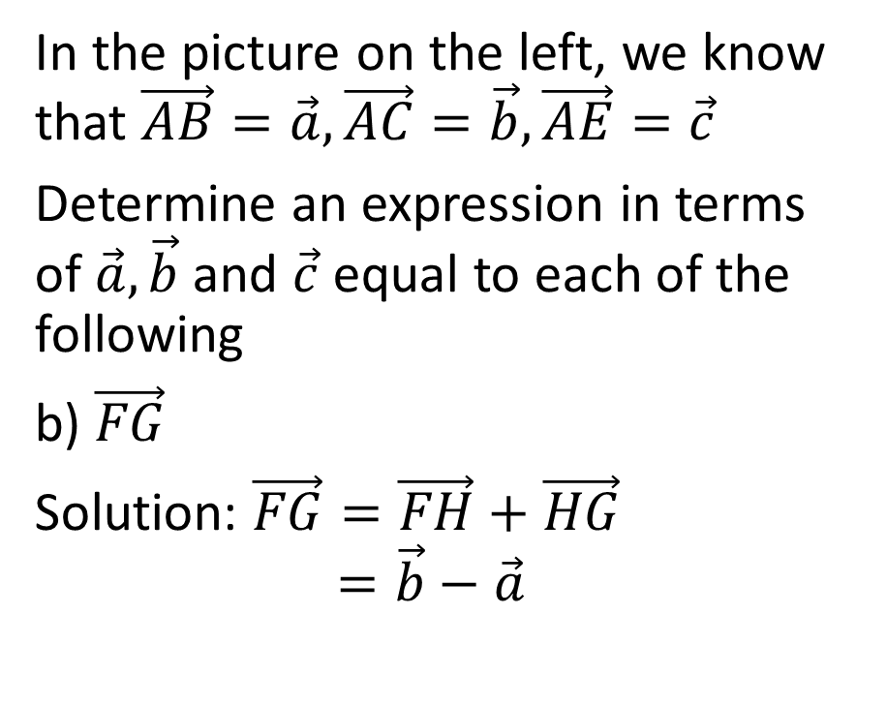
Example
In the picture on the left, we know that $\vec{AB}=\vec{a},\vec{AC}=\vec{b},\vec{AE}=\vec{c}$
Determine an expression in terms of $\vec{a}, \vec{b}$ and $\vec{c}$ equal to each of the following
b) $\vec{FG}$
Solution: $\vec{FG}=\vec{FH}+\vec{HG}$
$$=\vec{b}−\vec{a}$$

Slide 40
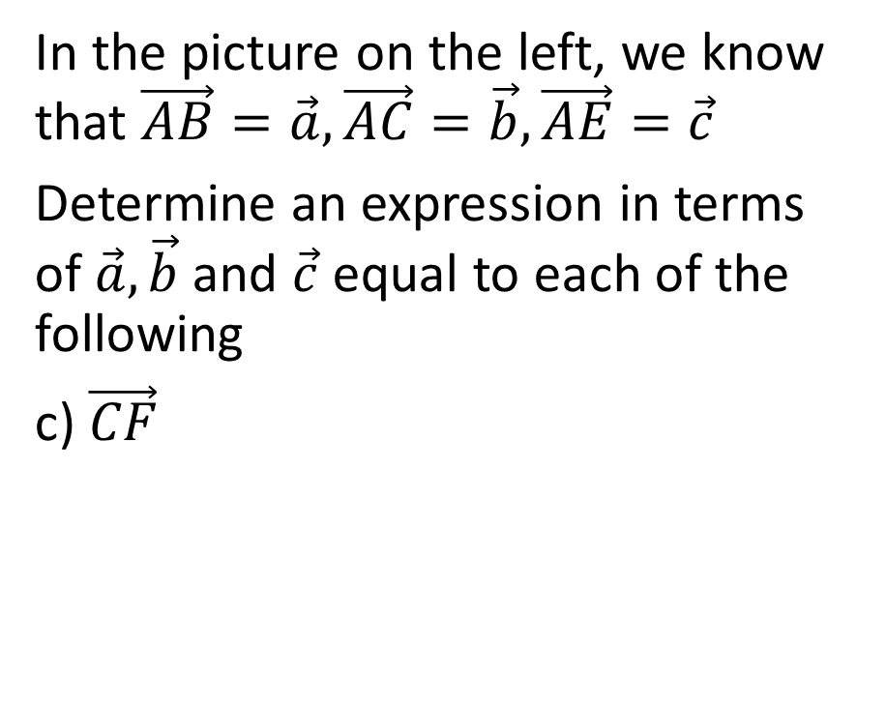
Example
In the picture on the left, we know that $\vec{AB}=\vec{a},\vec{AC}=\vec{b},\vec{AE}=\vec{c}$
Determine an expression in terms of $\vec{a}, \vec{b}$ and $\vec{c}$ equal to each of the following
c) $\vec{CF}$

Slide 41
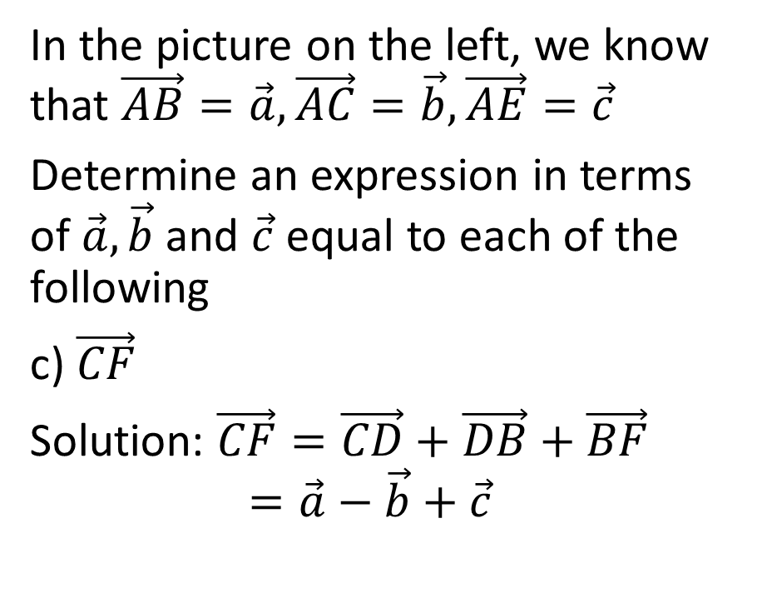
Example
In the picture on the left, we know that $\vec{AB}=\vec{a},\vec{AC}=\vec{b},\vec{AE}=\vec{c}$
Determine an expression in terms of $\vec{a}, \vec{b}$ and $\vec{c}$ equal to each of the following
c) $\vec{CF}$
Solution: $\vec{CF}=\vec{CD}+\vec{DB}+\vec{BF}$
$$=\vec{a}−\vec{b}+\vec{c}$$

Slide 42
Representing Vectors on a Cartesian Plane

Slide 43
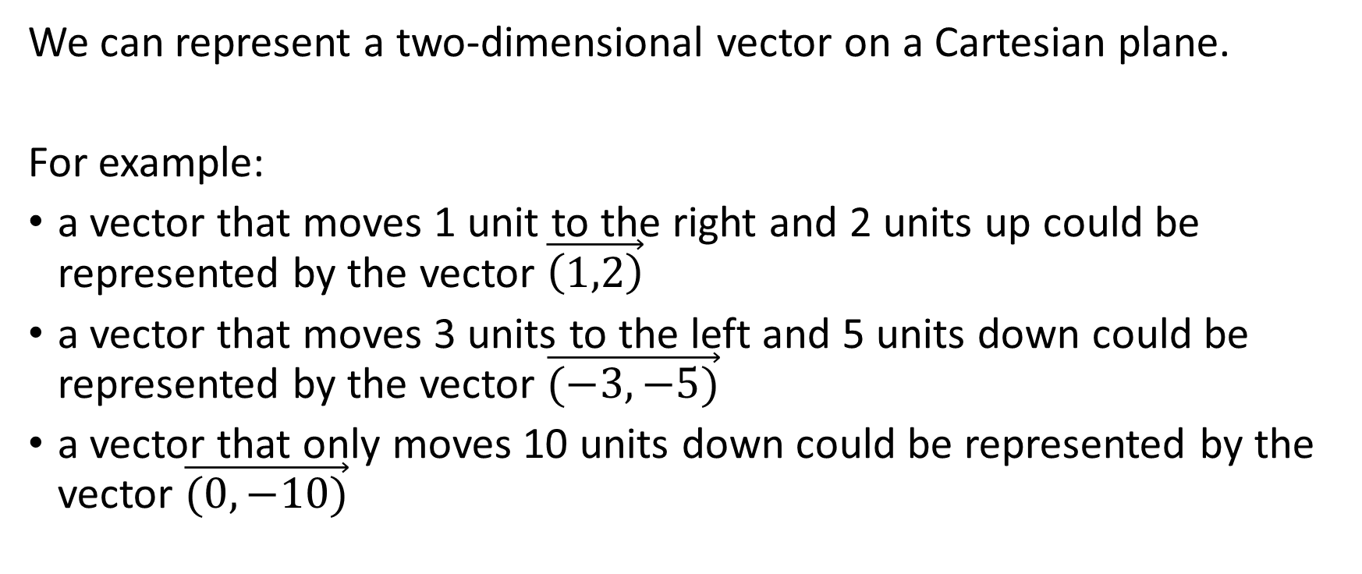
Components
We can represent a two-dimensional vector on a Cartesian plane.
For example:
a vector that moves 1 unit to the right and 2 units up could be represented by the vector $\vec{\left(1,2\right)}$
a vector that moves 3 units to the left and 5 units down could be represented by the vector $\vec{(−3,−5)}$
a vector that only moves 10 units down could be represented by the vector $\vec{(0,−10)}$

Slide 44
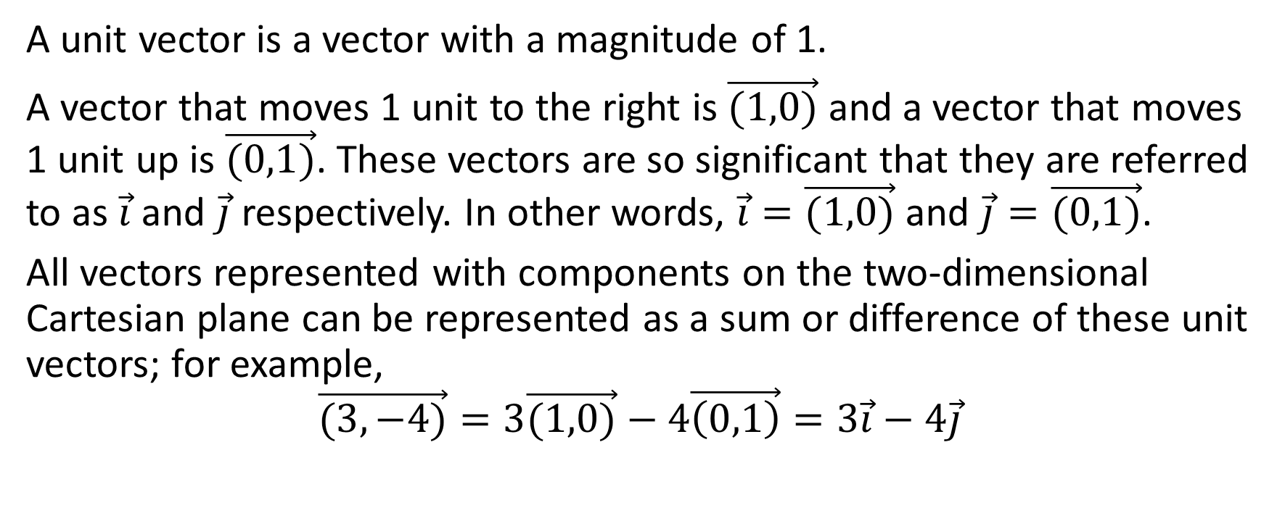
Unit Vectors on the Cartesian Plane
A unit vector is a vector with a magnitude of 1.
A vector that moves 1 unit to the right is $\vec{(1,0)}$ and a vector that moves 1 unit up is $\vec{(0,1)}$. These vectors are so significant that they are referred to as $\vec{i}$ and $\vec{j}$ respectively. In other words, $\vec{i}=\vec{(1,0)}$ and $\vec{j}=\vec{(0,1)}$.
All vectors represented with components on the two-dimensional Cartesian plane can be represented as a sum or difference of these unit vectors; for example,
$$\vec{(3,−4)}=3\vec{(1,0)}−4\vec{\left(0,1\right)}=3\vec{i}−4\vec{j}$$

Slide 45
Distributive Property with Vectors

Slide 46

Distributive Property with Vectors in Component Form Example
Simplify $3\left(2\vec{a}−5\vec{b}+\vec{c}\right)−2\left(\vec{a}−4\vec{b}+6\vec{c}\right)$

Slide 47

Simplify $3\left(2\vec{a}−5\vec{b}+\vec{c}\right)−2\left(\vec{a}−4\vec{b}+6\vec{c}\right)$
Solution:
$3\left(2\vec{a}−5\vec{b}+\vec{c}\right)−2\left(\vec{a}−4\vec{b}+6\vec{c}\right)$ $=6\vec{a}−15\vec{b}+3\vec{c}−2\vec{a}+8\vec{b}−12\vec{c}$
$$=4\vec{a}−7\vec{b}−9\vec{c}$$

Slide 48

Example:
Given that $\vec{u}=\left(3,−1\right),\vec{v}=\left(−4,−7\right),\vec{w}=(10,1)$, state the components of the vector $4\vec{u}+2\vec{v}−7\vec{w}$

Slide 49
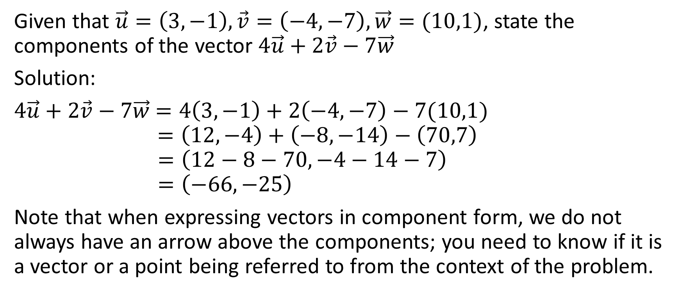
Given that $\vec{u}=\left(3,−1\right),\vec{v}=\left(−4,−7\right),\vec{w}=(10,1)$, state the components of the vector $4\vec{u}+2\vec{v}−7\vec{w}$
Solution:
$4\vec{u}+2\vec{v}−7\vec{w}$ $=4\left(3,−1\right)+2\left(−4,−7\right)−7(10,1)$
$$=\left(12,−4\right)+\left(−8,−14\right)−\left(70,7\right)$$
$$=\left(12−8−70,−4−14−7\right)$$
$$=\left(−66,−25\right)$$
Note that when expressing vectors in component form, we do not always have an arrow above the components; you need to know if it is a vector or a point being referred to from the context of the problem.

Slide 50
Another Type of Question
The “Taking Different Paths” Questions

Slide 51



.

Slide 52
.
We address questions like this by “taking different paths”

Slide 53
.
We address questions like this by “taking different paths”
For example, we can go from B to F by going from B to A to E to F.

Slide 54
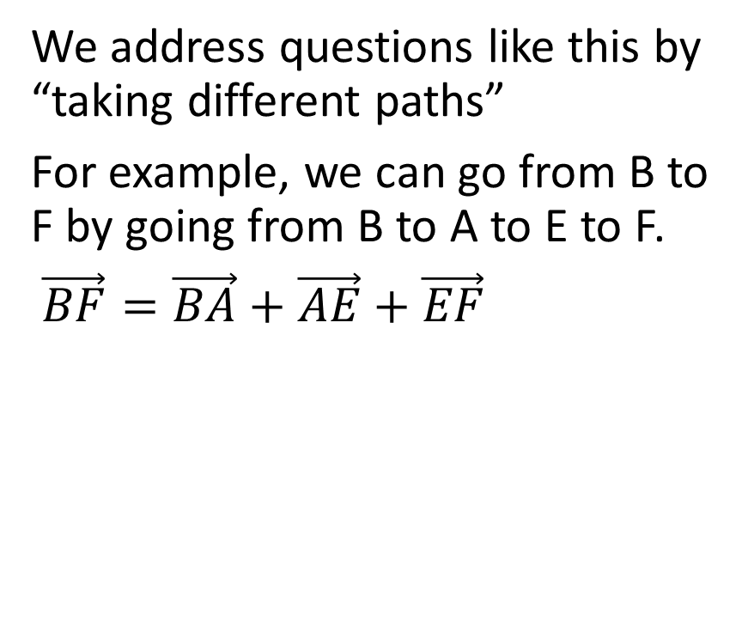

.
We address questions like this by “taking different paths”
For example, we can go from B to F by going from B to A to E to F.
$\vec{BF}=\vec{BA}+\vec{AE}+\vec{EF}$

Slide 55
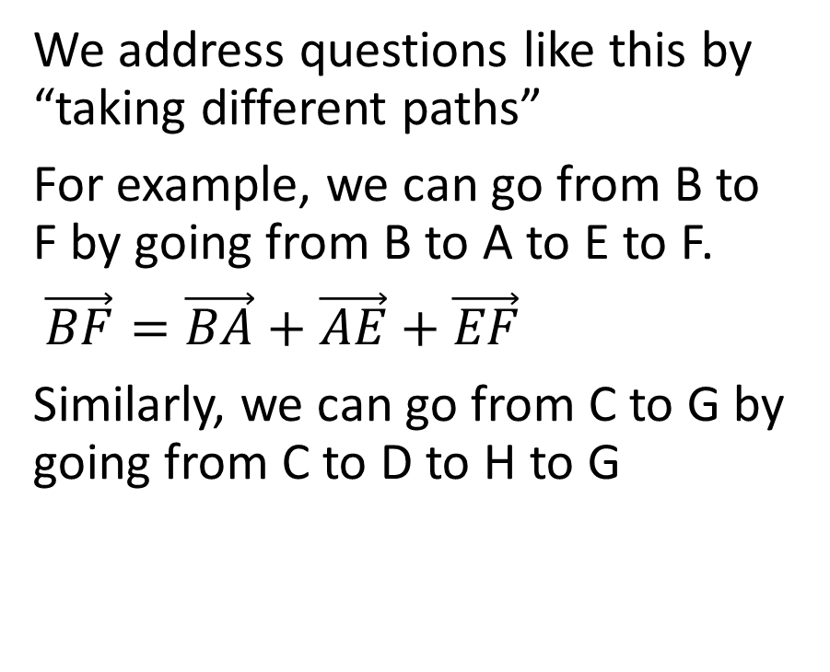
.
We address questions like this by “taking different paths”
For example, we can go from B to F by going from B to A to E to F.
$\vec{BF}=\vec{BA}+\vec{AE}+\vec{EF}$
Similarly, we can go from C to G by going from C to D to H to G

Slide 56
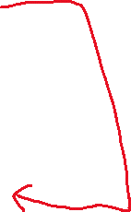
.
We address questions like this by “taking different paths”
For example, we can go from B to F by going from B to A to E to F.
$\vec{BF}=\vec{BA}+\vec{AE}+\vec{EF}$
Similarly, we can go from C to G by going from C to D to H to G

Slide 57
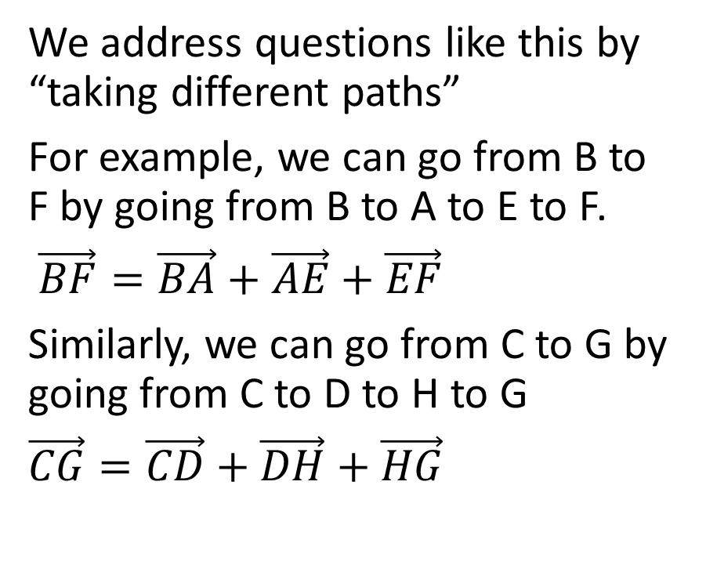
.
We address questions like this by “taking different paths”
For example, we can go from B to F by going from B to A to E to F.
$\vec{BF}=\vec{BA}+\vec{AE}+\vec{EF}$
Similarly, we can go from C to G by going from C to D to H to G
$\vec{CG}=\vec{CD}+\vec{DH}+\vec{HG}$

Slide 58
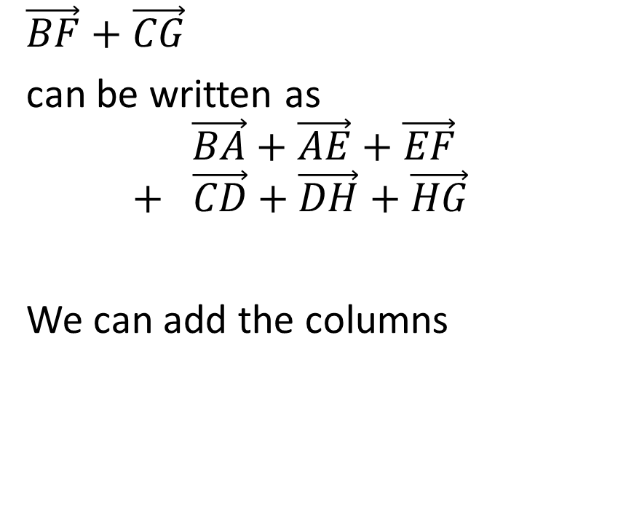
.
$\vec{BF}+\vec{CG}$
can be written as
$$\vec{BA}+\vec{AE}+\vec{EF}$$
$$+ \vec{CD}+\vec{DH}+\vec{HG}$$
We can add the columns

Slide 59
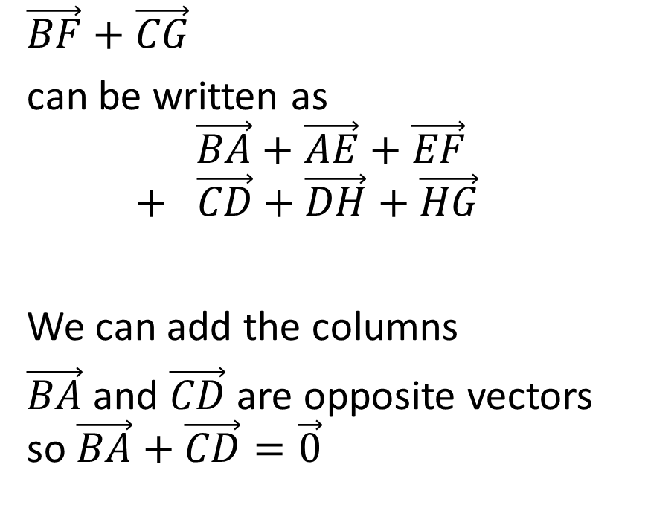
.
$\vec{BF}+\vec{CG}$
can be written as
$$\vec{BA}+\vec{AE}+\vec{EF}$$
$$+ \vec{CD}+\vec{DH}+\vec{HG}$$
We can add the columns
$\vec{BA}$ and $\vec{CD}$ are opposite vectors so $\vec{BA}+\vec{CD}=\vec{0}$

Slide 60
.
$\vec{BF}+\vec{CG}$
can be written as
$$\vec{BA}+\vec{AE}+\vec{EF}$$
$$+ \vec{CD}+\vec{DH}+\vec{HG}$$
We can add the columns
$\vec{BA}$ and $\vec{CD}$ are opposite vectors so $\vec{BA}+\vec{CD}=\vec{0}$

Slide 61
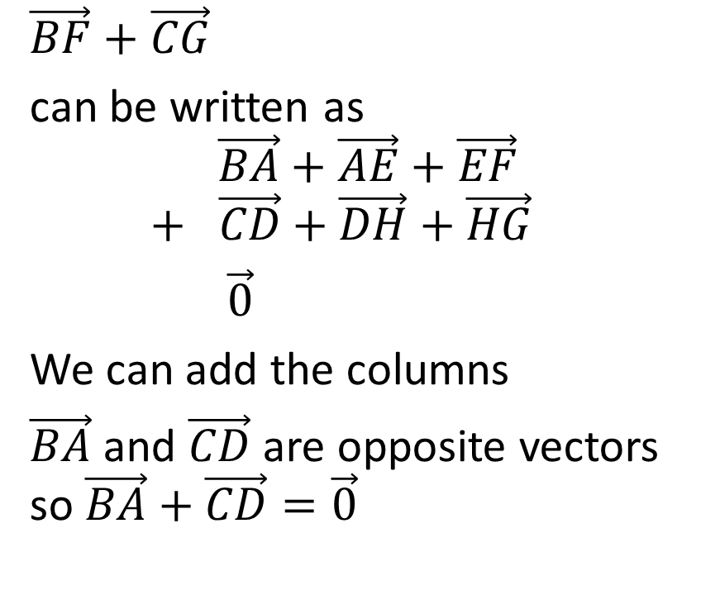
.
$\vec{BF}+\vec{CG}$
can be written as
$$\vec{BA}+\vec{AE}+\vec{EF}$$
$$+ \vec{CD}+\vec{DH}+\vec{HG}$$
$\vec{0}$
We can add the columns
$\vec{BA}$ and $\vec{CD}$ are opposite vectors so $\vec{BA}+\vec{CD}=\vec{0}$

Slide 62
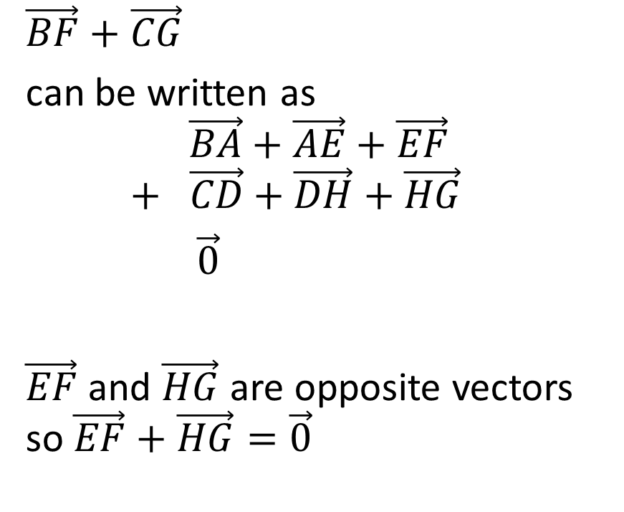
.
$\vec{BF}+\vec{CG}$
can be written as
$$\vec{BA}+\vec{AE}+\vec{EF}$$
$$+ \vec{CD}+\vec{DH}+\vec{HG}$$
$\vec{0}$
$\vec{EF}$ and $\vec{HG}$ are opposite vectors so $\vec{EF}+\vec{HG}=\vec{0}$

Slide 63
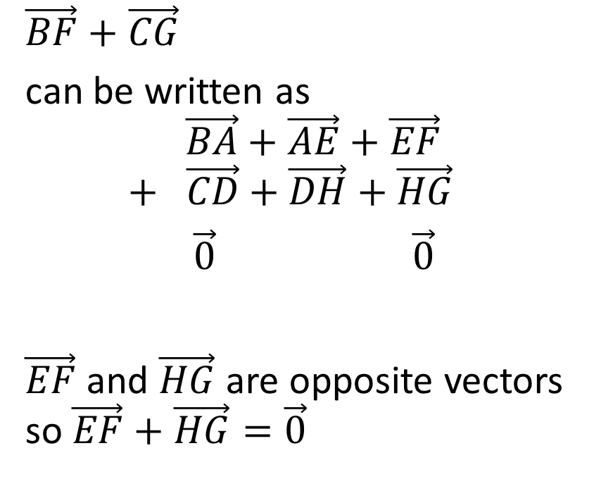
.
$\vec{BF}+\vec{CG}$
can be written as
$$\vec{BA}+\vec{AE}+\vec{EF}$$
$$+ \vec{CD}+\vec{DH}+\vec{HG}$$
$\vec{0}$ $\vec{0}$
$\vec{EF}$ and $\vec{HG}$ are opposite vectors so $\vec{EF}+\vec{HG}=\vec{0}$

Slide 64
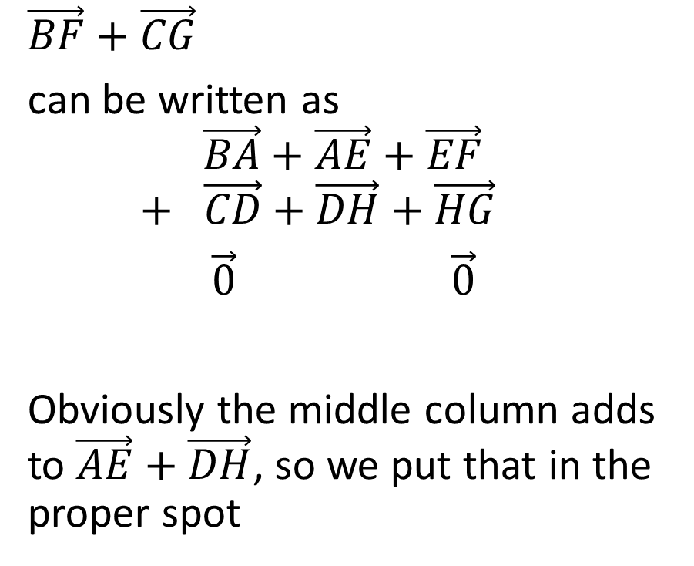
.
$\vec{BF}+\vec{CG}$
can be written as
$$\vec{BA}+\vec{AE}+\vec{EF}$$
$$+ \vec{CD}+\vec{DH}+\vec{HG}$$
$\vec{0}$ $\vec{0}$
Obviously the middle column adds to $\vec{AE}+\vec{DH}$, so we put that in the proper spot

Slide 65
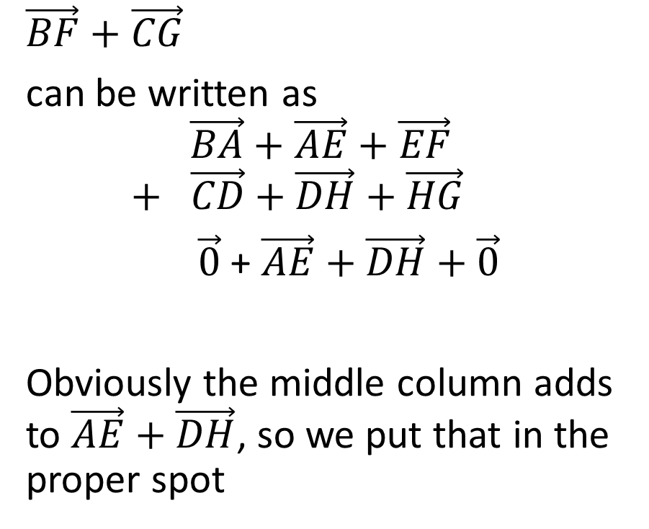
.
$\vec{BF}+\vec{CG}$
can be written as
$$\vec{BA}+\vec{AE}+\vec{EF}$$
$$+ \vec{CD}+\vec{DH}+\vec{HG}$$
$\vec{0}$ + $\vec{AE}+\vec{DH}+$ $\vec{0}$
Obviously the middle column adds to $\vec{AE}+\vec{DH}$, so we put that in the proper spot

Slide 66
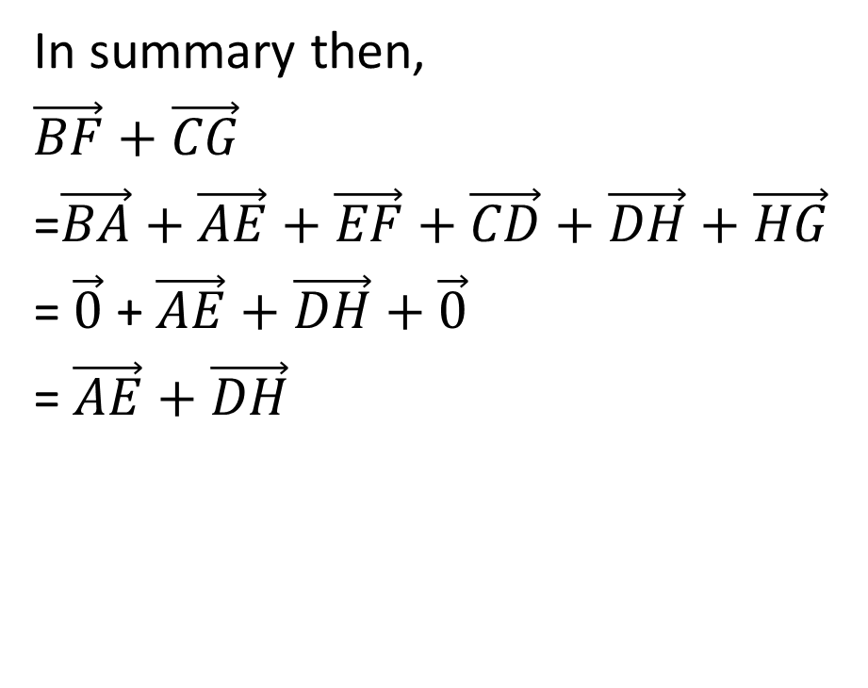
.
In summary then,
$\vec{BF}+\vec{CG}$
=$\vec{BA}+\vec{AE}+\vec{EF}+\vec{CD}+\vec{DH}+\vec{HG}$
= $\vec{0}$ + $\vec{AE}+\vec{DH}+$ $\vec{0}$
= $\vec{AE}+\vec{DH}$

Slide 67
Example

Slide 68

Example
You are given that $\vec{AD}=\frac{3}{5}\vec{BC}$
Prove: $\vec{AE}=\frac{5}{8}\vec{AD}+\frac{3}{8}\vec{AB}$

Slide 69

Example
You are given that $\vec{AD}=\frac{3}{5}\vec{BC}$
Prove: $\vec{AE}=\frac{5}{8}\vec{AD}+\frac{3}{8}\vec{AB}$
Solution:
Because $\vec{AD}=\frac{3}{5}\vec{BC}$, therefore we know that the top side length and bottom side length are parallel.

Slide 70
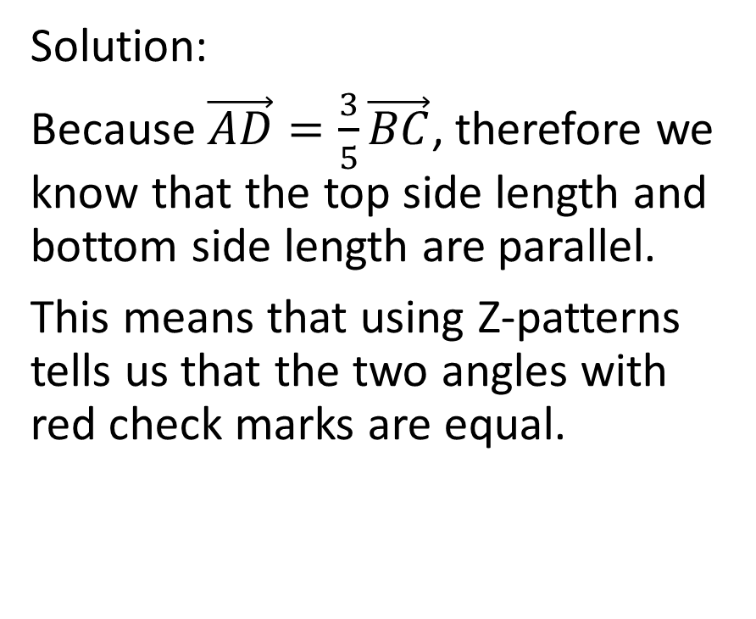
Example
You are given that $\vec{AD}=\frac{3}{5}\vec{BC}$
Prove: $\vec{AE}=\frac{5}{8}\vec{AD}+\frac{3}{8}\vec{AB}$
Solution:
Because $\vec{AD}=\frac{3}{5}\vec{BC}$, therefore we know that the top side length and bottom side length are parallel.
This means that using Z-patterns tells us that the two angles with red check marks are equal.

Slide 71
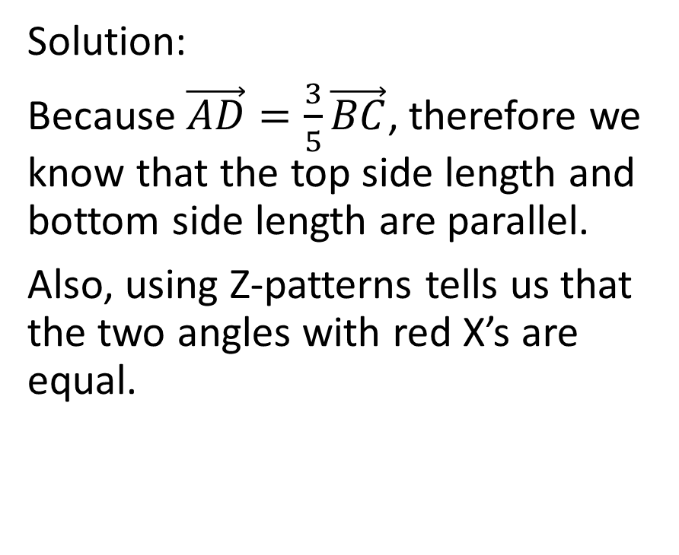
Example
You are given that $\vec{AD}=\frac{3}{5}\vec{BC}$
Prove: $\vec{AE}=\frac{5}{8}\vec{AD}+\frac{3}{8}\vec{AB}$
Solution:
Because $\vec{AD}=\frac{3}{5}\vec{BC}$, therefore we know that the top side length and bottom side length are parallel.
Also, using Z-patterns tells us that the two angles with red X’s are equal.

Slide 72
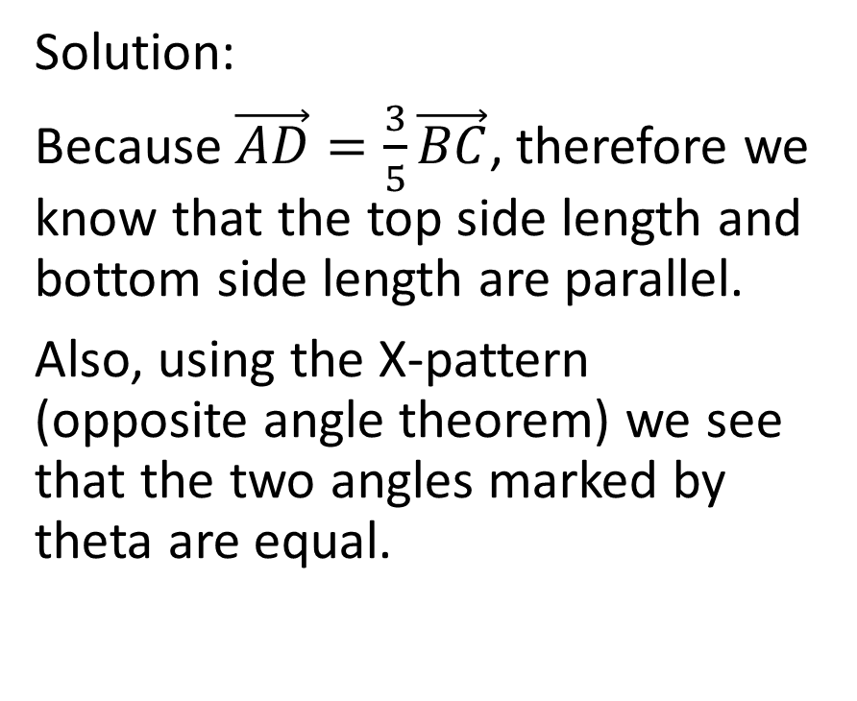
Example
You are given that $\vec{AD}=\frac{3}{5}\vec{BC}$
Prove: $\vec{AE}=\frac{5}{8}\vec{AD}+\frac{3}{8}\vec{AB}$
Solution:
Because $\vec{AD}=\frac{3}{5}\vec{BC}$, therefore we know that the top side length and bottom side length are parallel.
Also, using the X-pattern (opposite angle theorem) we see that the two angles marked by theta are equal.

Slide 73
Example
You are given that $\vec{AD}=\frac{3}{5}\vec{BC}$
Prove: $\vec{AE}=\frac{5}{8}\vec{AD}+\frac{3}{8}\vec{AB}$
Solution:
Now, notice that triangle ADE and triangle CBE have the same three angles. This means that they are similar triangles

Slide 74
Example
You are given that $\vec{AD}=\frac{3}{5}\vec{BC}$
Prove: $\vec{AE}=\frac{5}{8}\vec{AD}+\frac{3}{8}\vec{AB}$
Solution:
Now, notice that triangle ADE and triangle CBE have the same three angles. This means that they are similar triangles
AD is three fifths as long as BC. That means that if AD is 3 green units long, then BC is 5 green units long.

Slide 75
Example
You are given that $\vec{AD}=\frac{3}{5}\vec{BC}$
Prove: $\vec{AE}=\frac{5}{8}\vec{AD}+\frac{3}{8}\vec{AB}$
Solution:
Now, notice that triangle ADE and triangle CBE have the same three angles. This means that they are similar triangles
AD is three fifths as long as BC. That means that if AD is 3 green units long, then BC is 5 green units long.

Slide 76
Example
You are given that $\vec{AD}=\frac{3}{5}\vec{BC}$
Prove: $\vec{AE}=\frac{5}{8}\vec{AD}+\frac{3}{8}\vec{AB}$
Solution:
Since the side lengths between the x and the check mark are in a 3:5 ratio, therefore the side lengths between the x and the theta are in a 3:5 ratio.

Slide 77
Example
You are given that $\vec{AD}=\frac{3}{5}\vec{BC}$
Prove: $\vec{AE}=\frac{5}{8}\vec{AD}+\frac{3}{8}\vec{AB}$
Solution:
Since the side lengths between the x and the check mark are in a 3:5 ratio, therefore the side lengths between the x and the theta are in a 3:5 ratio.
Therefore, if the top triangle’s side length between the x and theta is 3 orange units long, then the bottom triangle’s is 5 orange units

Slide 78


Example
You are given that $\vec{AD}=\frac{3}{5}\vec{BC}$
Prove: $\vec{AE}=\frac{5}{8}\vec{AD}+\frac{3}{8}\vec{AB}$
Solution:
Since the side lengths between the x and the check mark are in a 3:5 ratio, therefore the side lengths between the x and the theta are in a 3:5 ratio.
Therefore, if the top triangles side length between the x and theta is 3 orange units long, then the bottom triangle’s is 5 orange units

Slide 79
Example
You are given that $\vec{AD}=\frac{3}{5}\vec{BC}$
Prove: $\vec{AE}=\frac{5}{8}\vec{AD}+\frac{3}{8}\vec{AB}$
Solution:
Finally, the last sides are in a 3:5 ratio. So if the last side of the top triangle is 3 blue units long, then the last side of the bottom triangle is 5 blue units long.

Slide 80

Example
You are given that $\vec{AD}=\frac{3}{5}\vec{BC}$
Prove: $\vec{AE}=\frac{5}{8}\vec{AD}+\frac{3}{8}\vec{AB}$
Solution:
Finally, the last sides are in a 3:5 ratio. So if the last side of the top triangle is 3 blue units long, then the last side of the bottom triangle is 5 blue units long.

Slide 81
Example
You are given that $\vec{AD}=\frac{3}{5}\vec{BC}$
Prove: $\vec{AE}=\frac{5}{8}\vec{AD}+\frac{3}{8}\vec{AB}$
Solution:
Now, we start by writing an equation that is directionally consistent with the equation we’re trying to prove.

Slide 82
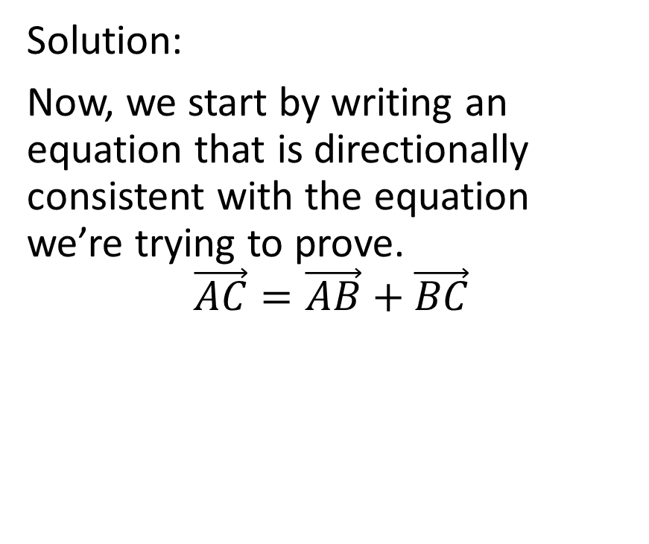
Example
You are given that $\vec{AD}=\frac{3}{5}\vec{BC}$
Prove: $\vec{AE}=\frac{5}{8}\vec{AD}+\frac{3}{8}\vec{AB}$
Solution:
Now, we start by writing an equation that is directionally consistent with the equation we’re trying to prove.
$$\vec{AC}=\vec{AB}+\vec{BC}$$

Slide 83
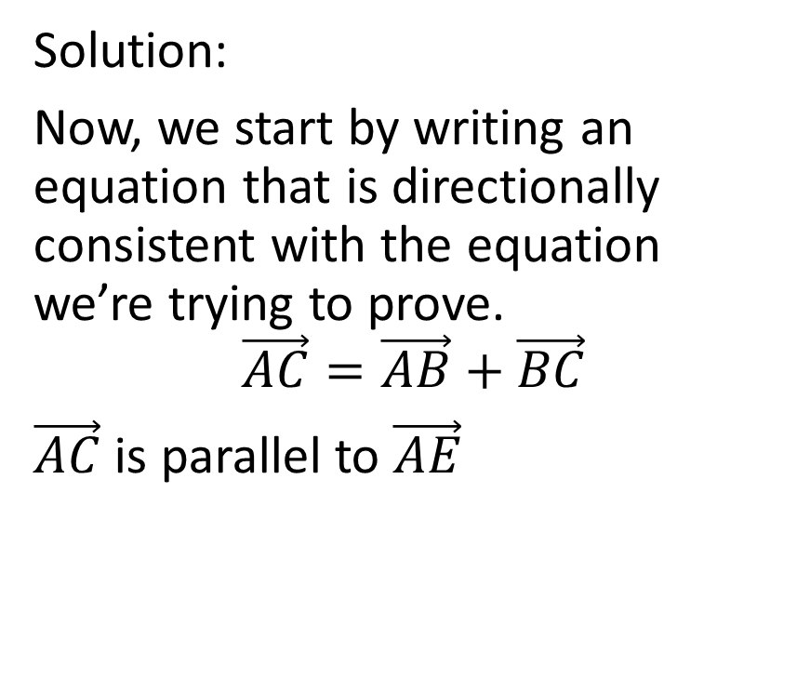
Example
You are given that $\vec{AD}=\frac{3}{5}\vec{BC}$
Prove: $\vec{AE}=\frac{5}{8}\vec{AD}+\frac{3}{8}\vec{AB}$
Solution:
Now, we start by writing an equation that is directionally consistent with the equation we’re trying to prove.
$$\vec{AC}=\vec{AB}+\vec{BC}$$
$\vec{AC}$ is parallel to $\vec{AE}$

Slide 84
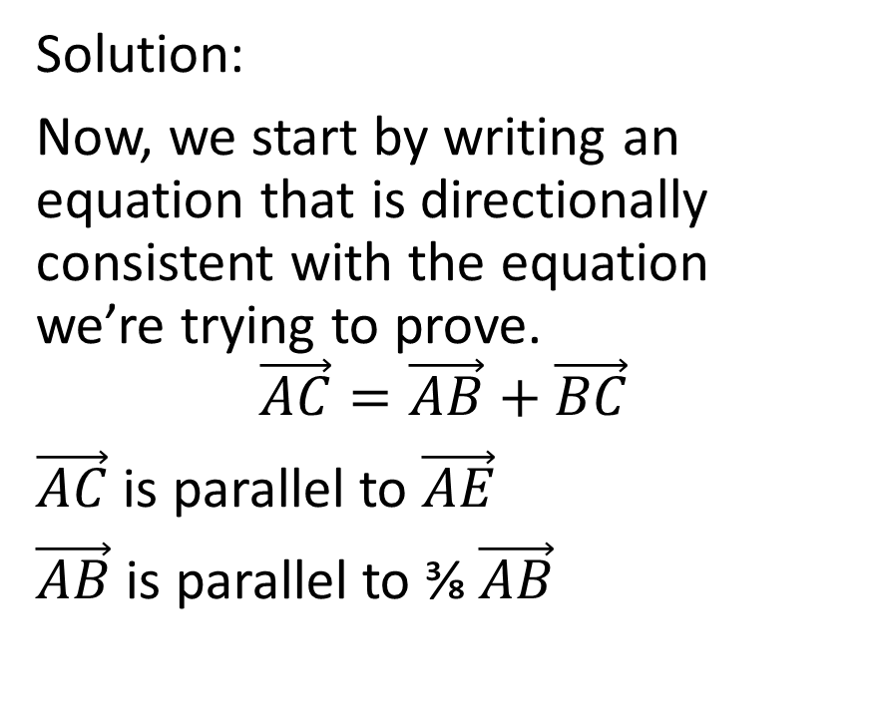
Example
You are given that $\vec{AD}=\frac{3}{5}\vec{BC}$
Prove: $\vec{AE}=\frac{5}{8}\vec{AD}+\frac{3}{8}\vec{AB}$
Solution:
Now, we start by writing an equation that is directionally consistent with the equation we’re trying to prove.
$$\vec{AC}=\vec{AB}+\vec{BC}$$
$\vec{AC}$ is parallel to $\vec{AE}$
$\vec{AB}$ is parallel to ⅜$\vec{AB}$

Slide 85
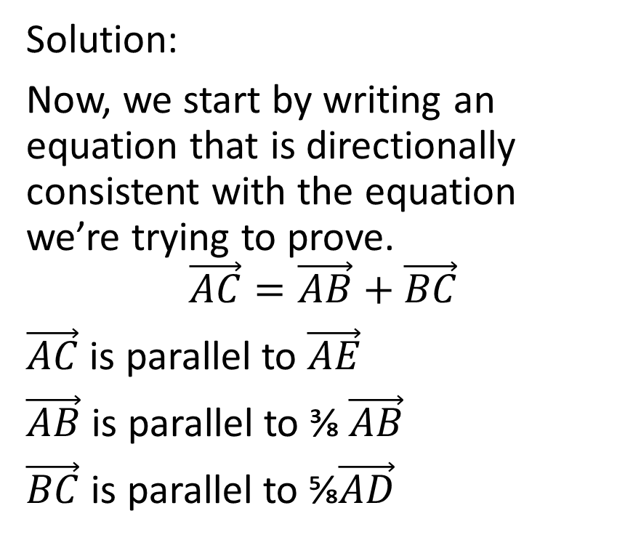
Example
You are given that $\vec{AD}=\frac{3}{5}\vec{BC}$
Prove: $\vec{AE}=\frac{5}{8}\vec{AD}+\frac{3}{8}\vec{AB}$
Solution:
Now, we start by writing an equation that is directionally consistent with the equation we’re trying to prove.
$$\vec{AC}=\vec{AB}+\vec{BC}$$
$\vec{AC}$ is parallel to $\vec{AE}$
$\vec{AB}$ is parallel to ⅜$\vec{AB}$
$\vec{BC}$ is parallel to ⅝$\vec{AD}$

Slide 86

Example
You are given that $\vec{AD}=\frac{3}{5}\vec{BC}$
Prove: $\vec{AE}=\frac{5}{8}\vec{AD}+\frac{3}{8}\vec{AB}$
Solution:
$$\vec{AC}=\vec{AB}+\vec{BC}$$

Slide 87
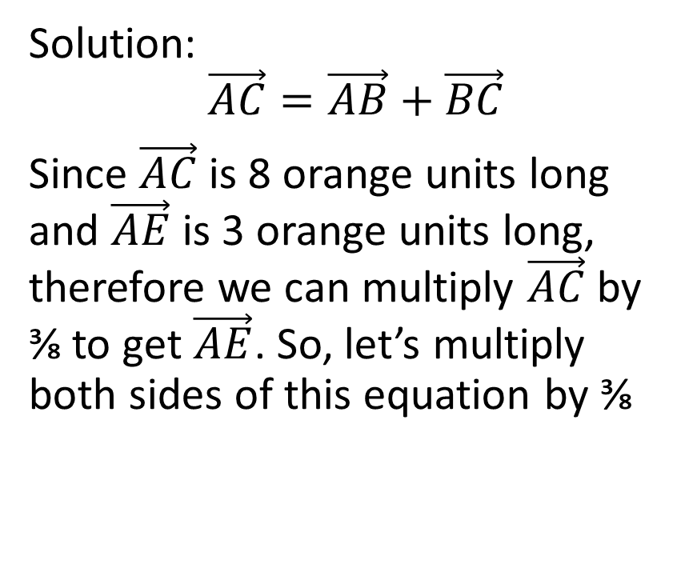
Example
You are given that $\vec{AD}=\frac{3}{5}\vec{BC}$
Prove: $\vec{AE}=\frac{5}{8}\vec{AD}+\frac{3}{8}\vec{AB}$
Solution:
$$\vec{AC}=\vec{AB}+\vec{BC}$$
Since $\vec{AC}$is 8 orange units long and $\vec{AE}$ is 3 orange units long, therefore we can multiply $\vec{AC}$by ⅜ to get $\vec{AE}$. So, let’s multiply both sides of this equation by ⅜

Slide 88

Example
You are given that $\vec{AD}=\frac{3}{5}\vec{BC}$
Prove: $\vec{AE}=\frac{5}{8}\vec{AD}+\frac{3}{8}\vec{AB}$
Solution:
$$\vec{AC}=\vec{AB}+\vec{BC}$$
$$\frac{3}{8}\vec{AC}=\frac{3}{8}\left(\vec{AB}+\vec{BC}\right)$$
$$\vec{AE}=\frac{3}{8}\vec{AB}+\frac{3}{8}\vec{BC}$$
$$\vec{AE}=\frac{3}{8}\vec{BC}+\frac{3}{8}\vec{AB}$$

Slide 89

Example
You are given that $\vec{AD}=\frac{3}{5}\vec{BC}$
Prove: $\vec{AE}=\frac{5}{8}\vec{AD}+\frac{3}{8}\vec{AB}$
Solution:
$$\vec{AC}=\vec{AB}+\vec{BC}$$
$$\frac{3}{8}\vec{AC}=\frac{3}{8}\left(\vec{AB}+\vec{BC}\right)$$
$$\vec{AE}=\frac{3}{8}\vec{AB}+\frac{3}{8}\vec{BC}$$
$$\vec{AE}=\frac{3}{8}\vec{BC}+\frac{3}{8}\vec{AB}$$
This is close

Slide 90

Example
You are given that $\vec{AD}=\frac{3}{5}\vec{BC}$
Prove: $\vec{AE}=\frac{5}{8}\vec{AD}+\frac{3}{8}\vec{AB}$
Solution:
$$\vec{AE}=\frac{3}{8}\vec{BC}+\frac{3}{8}\vec{AB}$$

Slide 91

Example
You are given that $\vec{AD}=\frac{3}{5}\vec{BC}$
Prove: $\vec{AE}=\frac{5}{8}\vec{AD}+\frac{3}{8}\vec{AB}$
Solution:
$$\vec{AE}=\frac{3}{8}\vec{BC}+\frac{3}{8}\vec{AB}$$
What is the relationship between $\vec{BC}$ and $\vec{AD}$?
The question tells us that
$\vec{AD}=\frac{3}{5}\vec{BC}$

Slide 92

Example
You are given that $\vec{AD}=\frac{3}{5}\vec{BC}$
Prove: $\vec{AE}=\frac{5}{8}\vec{AD}+\frac{3}{8}\vec{AB}$
Solution:
$$\vec{AE}=\frac{3}{8}\vec{BC}+\frac{3}{8}\vec{AB}$$
What is the relationship between $\vec{BC}$ and $\vec{AD}$?
The question tells us that
$\vec{AD}=\frac{3}{5}\vec{BC}$
Therefore, $\vec{BC}=\frac{5}{3}\vec{AD}$

Slide 93
Example
You are given that $\vec{AD}=\frac{3}{5}\vec{BC}$
Prove: $\vec{AE}=\frac{5}{8}\vec{AD}+\frac{3}{8}\vec{AB}$
Solution:
$$\vec{AE}=\frac{3}{8}\vec{BC}+\frac{3}{8}\vec{AB}$$

Slide 94

Example
You are given that $\vec{AD}=\frac{3}{5}\vec{BC}$
Prove: $\vec{AE}=\frac{5}{8}\vec{AD}+\frac{3}{8}\vec{AB}$
Solution:
$$\vec{AE}=\frac{3}{8}\vec{BC}+\frac{3}{8}\vec{AB}$$
$$\vec{AE}=\frac{3}{8}\left(\frac{5}{3}\vec{AD}\right)+\frac{3}{8}\vec{AB}$$

Slide 95

Example
You are given that $\vec{AD}=\frac{3}{5}\vec{BC}$
Prove: $\vec{AE}=\frac{5}{8}\vec{AD}+\frac{3}{8}\vec{AB}$
Solution:
$$\vec{AE}=\frac{3}{8}\vec{BC}+\frac{3}{8}\vec{AB}$$
$$\vec{AE}=\frac{3}{8}\left(\frac{5}{3}\vec{AD}\right)+\frac{3}{8}\vec{AB}$$
$$\vec{AE}=\frac{5}{8}\vec{AD}+\frac{3}{8}\vec{AB}$$

Slide 96

Example
You are given that $\vec{AD}=\frac{3}{5}\vec{BC}$
Prove: $\vec{AE}=\frac{5}{8}\vec{AD}+\frac{3}{8}\vec{AB}$
Solution:
$$\vec{AE}=\frac{3}{8}\vec{BC}+\frac{3}{8}\vec{AB}$$
$$\vec{AE}=\frac{3}{8}\left(\frac{5}{3}\vec{AD}\right)+\frac{3}{8}\vec{AB}$$
$$\vec{AE}=\frac{5}{8}\vec{AD}+\frac{3}{8}\vec{AB}$$

